Slide 1


DATA SCIENCE JOB SALARIES ANALYSIS
By Himanshu Nagapure

Slide 2



INTRODUCTION
In today's competitive job market, understanding salary trends in data science is crucial for professionals seeking career growth and employers making hiring decisions.
This report explores salary distributions, employment types, experience levels, job titles, and key trends affecting data professionals globally. Using statistical modeling and machine learning, we provide insights to help individuals make informed career choices.
LETS GET STARTED

Slide 3



EXPLORATORY DATA ANALYSIS
Through Exploratory Data Analysis (EDA), we've examined the structure of our data, identified key variables, outliers, and tested assumptions.
This has provided critical insights, guiding our choice of models for further analysis and ensuring our data is ready for more detailed investigation and reliable results

Slide 4

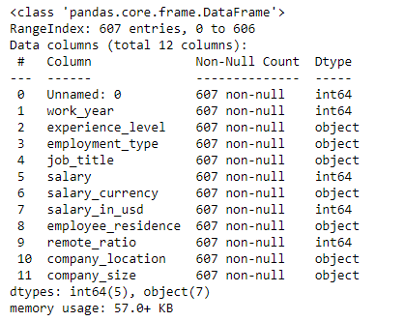
DATASET DESCRIPTION

Slide 5
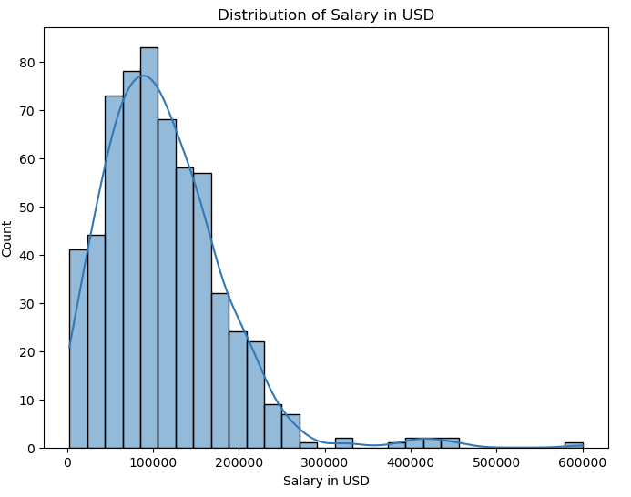
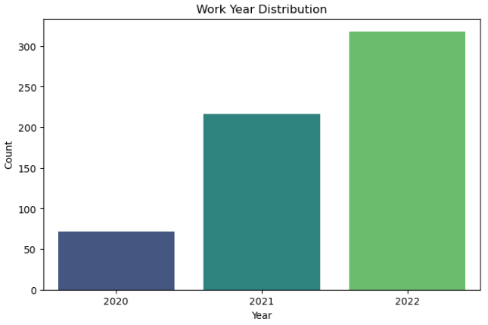
SALARY IN USD
WORK YEAR DISTRIBUTION
UNIVARIATE ANALYSIS
Insights:
The salary distribution for data science professionals is right-skewed, with a majority of professionals earning lower to mid-range salaries.
A noticeable peak in the distribution suggests a concentration of professionals within a specific salary range.
Insights:
The number of records grows from 2020 to 2022. This suggests more data is available for recent years, possibly due to an increase in data science jobs or better data collection.

Slide 6
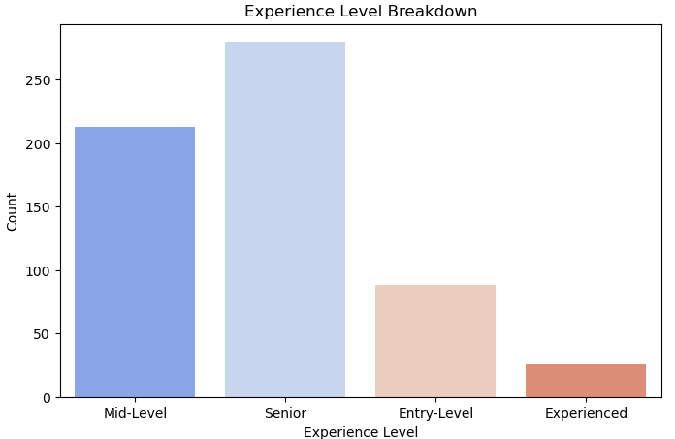
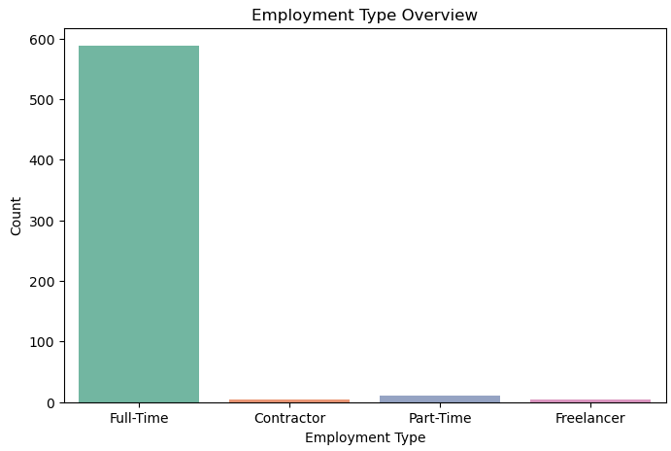
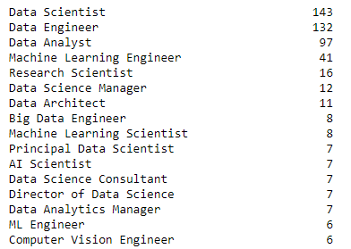
EXPERIENCE LEVEL
EMPLOYMENT TYPE
UNIVARIATE ANALYSIS

Slide 7
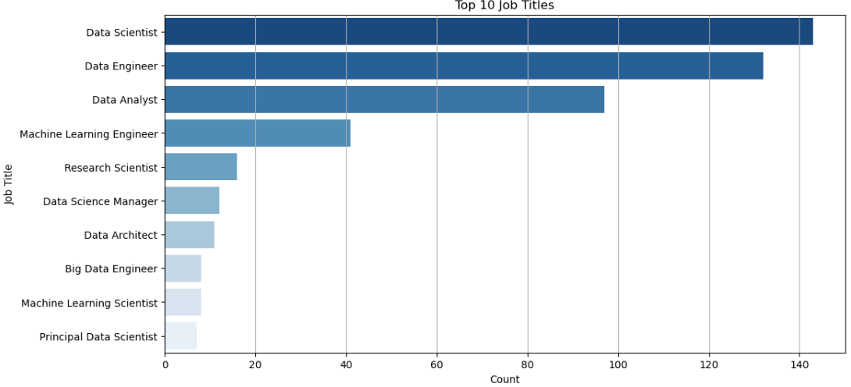
TOP 10 JOB TITLES
UNIVARIATE ANALYSIS

Slide 8
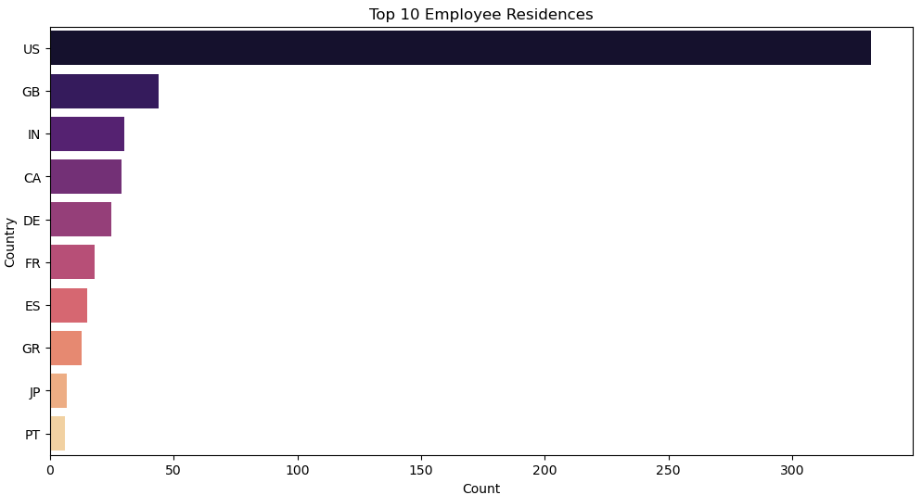
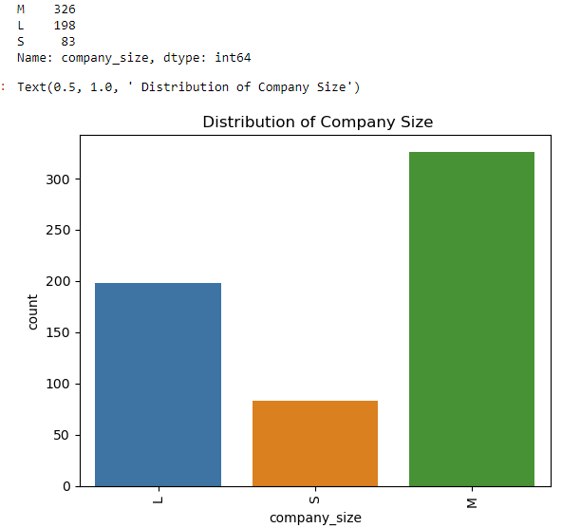
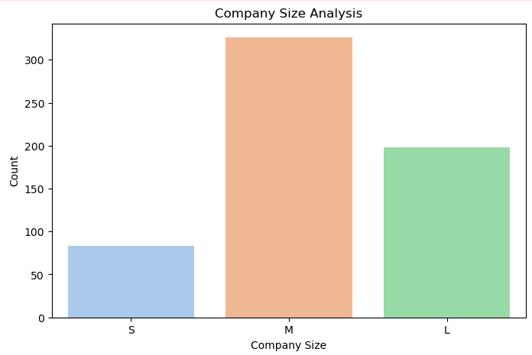
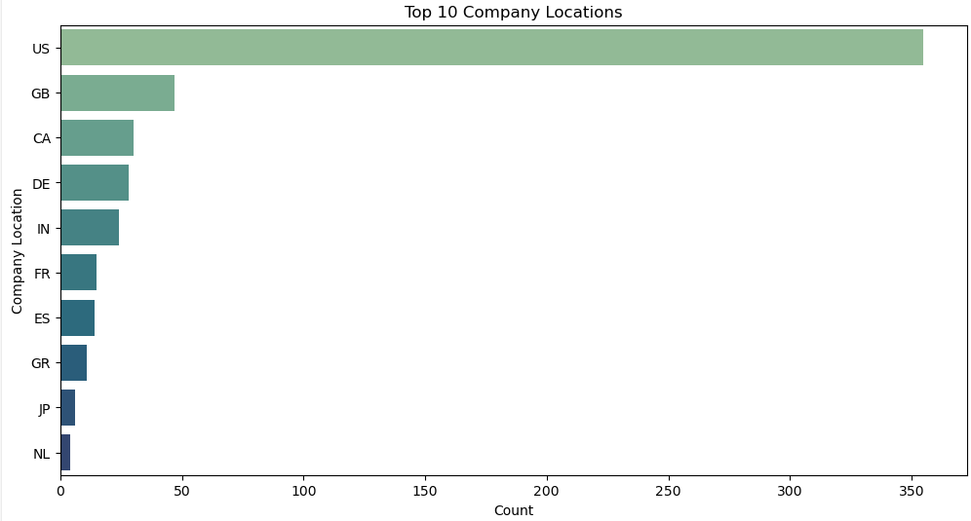
COMPANY SIZE
LOCATION
UNIVARIATE ANALYSIS

Slide 9
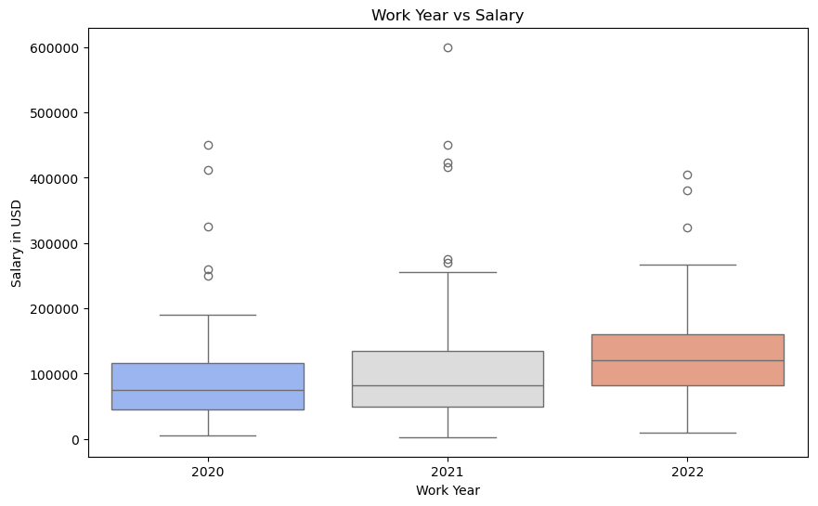
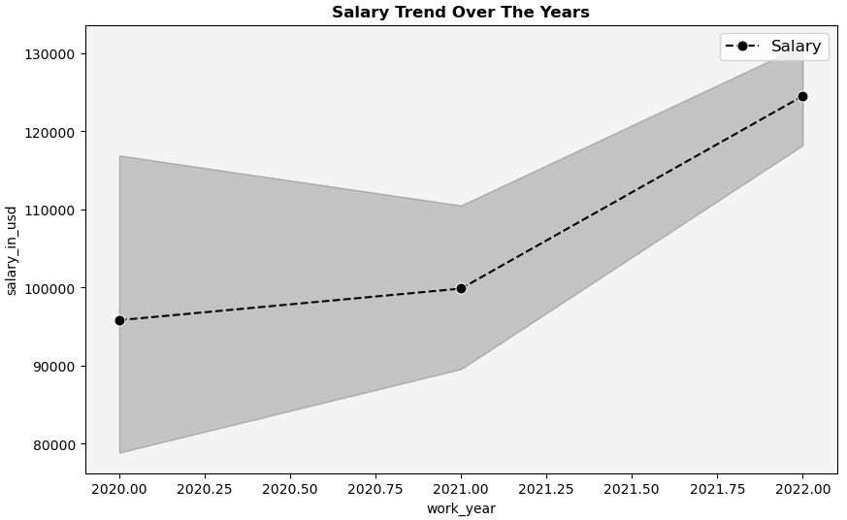
BIVARIATE
ANALYSIS
WORK YEAR ANALYSIS
Insights:
The median salary increases from 2020 to 2022, showing a positive salary trend in the data science field.
More high-paying roles are emerging, possibly due to demand for experienced professionals.

Slide 10
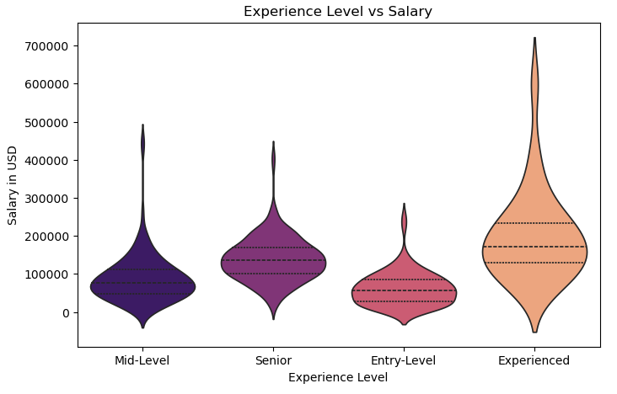
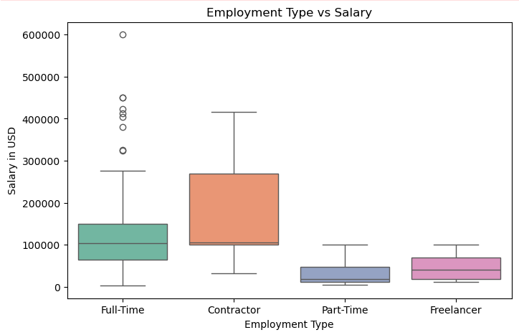
BIVARIATE
ANALYSIS
SALARY BY EXPERIENCE LEVEL
EMPLOYMENT TYPEVS SALARY
Insights:
More experience leads to higher pay, but the variation in salaries suggests that factors like company, location, and industry may also play a role.
Some professionals earn significantly higher salaries, possibly due to niche expertise or leadership roles.
Entry-level salaries are relatively low, reinforcing the need for experience and skill growth in the field.
Insights:
Contractors earn the most but have the highest salary variation.
Full-time employees have stable salaries with people with high-salaries than any others.
Part-time and freelancers earn the least, with lower salary variability.

Slide 11
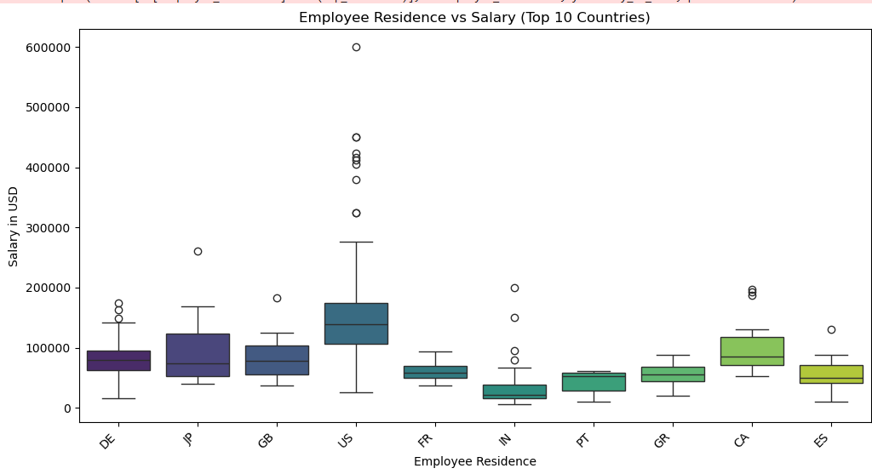
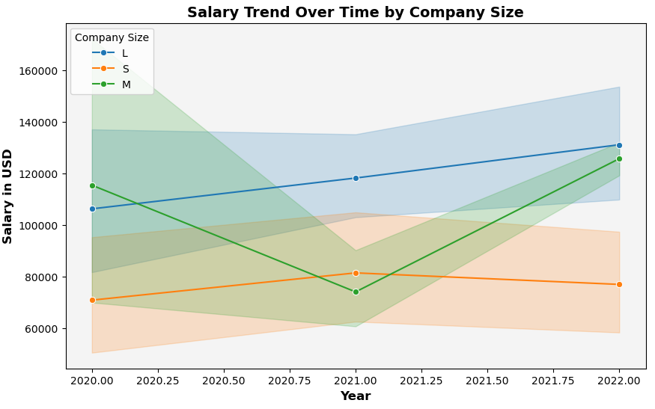
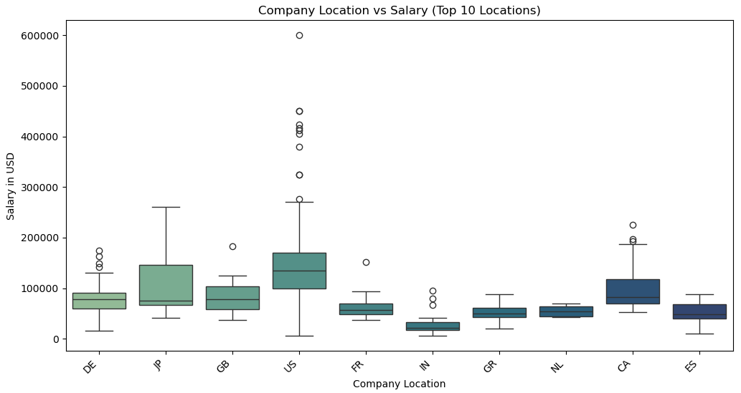
BIVARIATE
ANALYSIS
LOCATION
SALARY BY COMPANY SIZE
Insights:
The salary trend in medium-sized companies is increasing compared to small and large companies. The salary line in large companies is not fluctuating as much as in medium-sized companies.

Slide 12
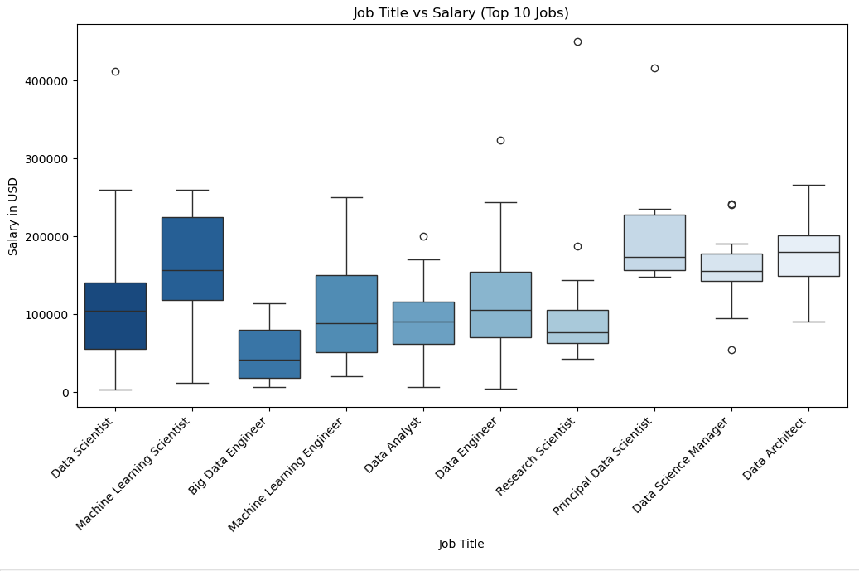
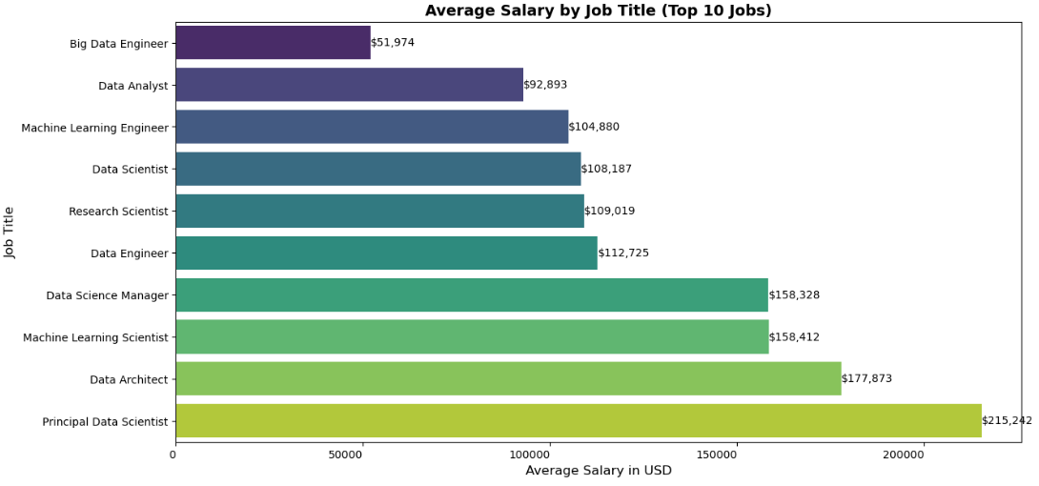
BIVARIATE
ANALYSIS
SALARY BY JOB TITLE
AVERAGE SALARY BY JOB TITLE
Insights:
Leadership and specialized roles (Data Science Manager, ML Scientist, Principal Data Scientist, Data Architect) have the highest salaries.
Technical roles (Data Scientist, Data Engineer, ML engineer, Research Scientist) have decent but varied salaries.
Entry-level roles (Data Analyst, Big Data Engineer) earn less but provide a stepping stone into higher-paying jobs.

Slide 13
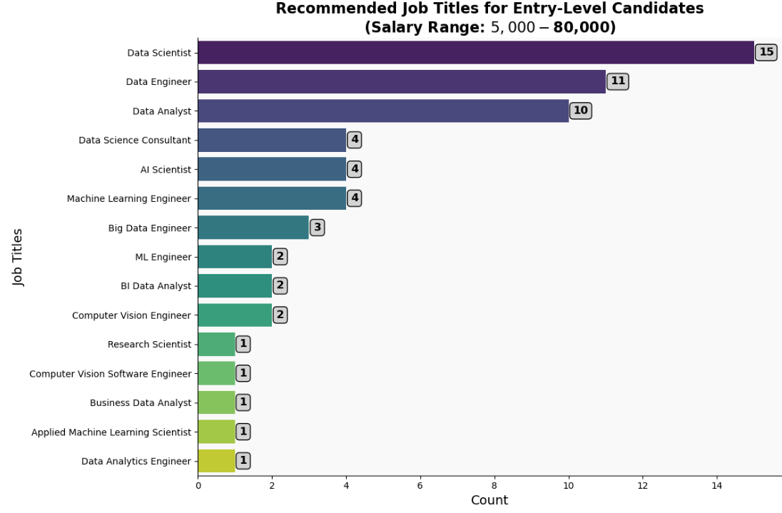
BONUS

Slide 14
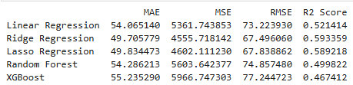
MODELING
From the results, Ridge Regression performed the best.
Lowest MAE (49.70) → Most accurate predictions on average.
Lowest MSE (4555.71) & RMSE (67.49) → Smaller errors overall.
Highest R² Score (0.5933) → Explains ~59.3% of variance in salary.

Slide 15
SUMMARY
This analysis provides a clear understanding of salary trends in data science and offers actionable recommendations for professionals at different career stages. By leveraging data-driven insights, individuals can make strategic career moves that maximize their earning potential and job satisfaction.
🚀 Key Takeaways:
Salary growth is influenced by experience, job role, company size, and location.
Medium-sized companies offer the best salary growth potential.
The US remains the best-paying country, with Japan and Canada emerging as strong alternatives.
Full-time roles provide stable salaries, while contracting offers higher but fluctuating pay.
For optimal salary growth, professionals should upskill in ML, AI, and cloud computing.
This report provides a data-backed roadmap for professionals looking to enhance their careers in data science. By using salary data effectively, candidates can make informed career decisions and negotiate better salaries with confidence.

Slide 16
THANK YOU

